Slide 1

Welcome to
Johnson Controls
We work to build the future

Slide 2

Narcis PICA
Sales Manager
Building Technologies & Solutions
Johnson Controls
Hermes Business Campus,
5 – 7 Dimitrie Pompeiu blvd., 204 office, Bucharest
Mobile +40730019187
narcis.pica@jci.com
www.johnsoncontrols.com

Slide 3












Johnson Controls today …
Nearly
140 Years
of innovation experience
150
countries offering
a local service from
100,000
experts globally
2000
locations
More than
9,200
active patents
4+ million
customers globally
$78 million
in charitable contributions
in the past 5 years
More than
+35.2M
metric tonnes of CO₂e reduced
for our customers since 2000
+1.86 million
volunteer hours
in the past 5 years
Named in
40+
leading sustainability
We are in
90%
of the world’s most
iconic buildings
Customers saved more than
$7.2 billion
in energy and operational
savings since 2000
100% increase
in energy productivity since 2022

Slide 4

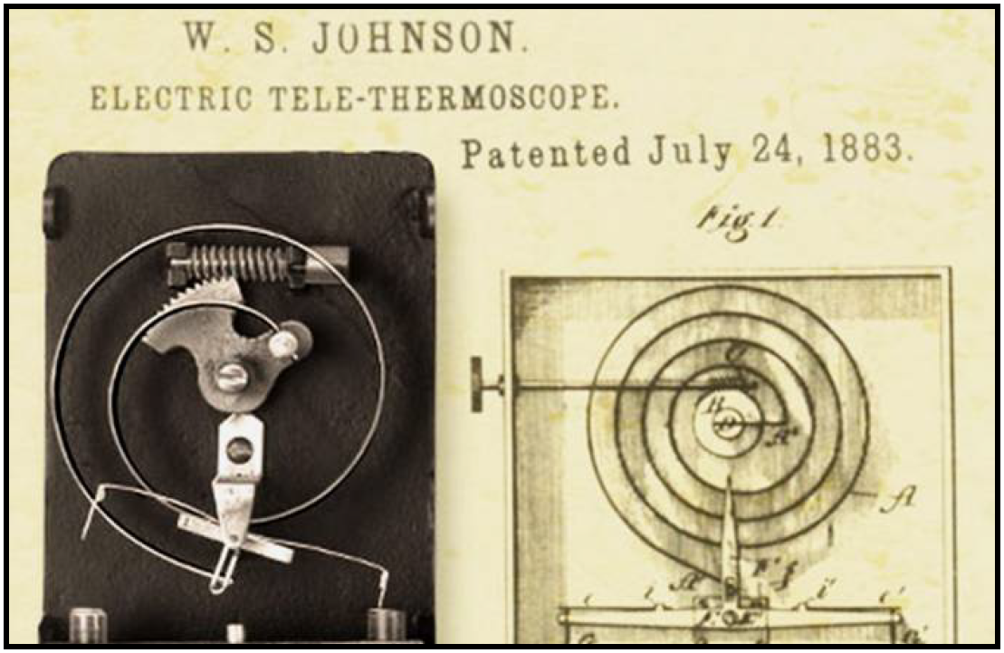
JCI Comprehensive Solutions …
Building Management System
Operational Intelligence and Loss Prevention
Lighting Control
HVAC Equipment
Fire & Hazard Detection and Protection
Security & Surveillance
Building Automation
Power Solutions
Building Services and Parts
Industrial Refrigeration

Slide 5






JCI Security portfolio …

Slide 6


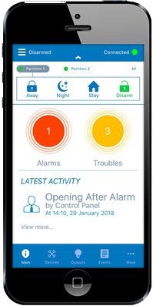
The actual series of DSC Hybrid systems, NEO and PRO …
Panels named NEO and PRO are the cores of DSC actual hybrid intrusion detection systems. Both can work stand alone, only wired, only wireless or mixed wired + wireless, integrated or not with other security & safety systems as a part of building security integrated systems.
Hybrid system = wired + wireless intrusion detectors

Slide 7
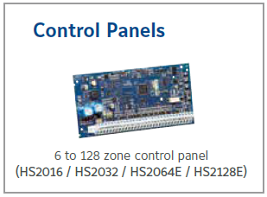
PowerSeries NEO …
RESIDENTIAL / SCALABLE COMMERCIAL SMALL & MEDIUM HYBRID SOLUTION
    Certified Grade 2 according EN50131 normative
    Versions: 16 / 32 / 64 / 128 zones, wired or wireless
    8 partitions
    16 keypads
    1000 user codes
    1000 event buffer
    4 on-board output “open collector” PGM
    Alarm protocols: Contact ID, SIA
    Encrypted Communications Bus, 128 Bit AES Encryption
    Interconnected smoke detector support with v1.2 allows for additional warning in potential life-threatening situations
    Visual alarm verification in day and night, in case of alarm from Motion Detector with Integrated Camera

Slide 8
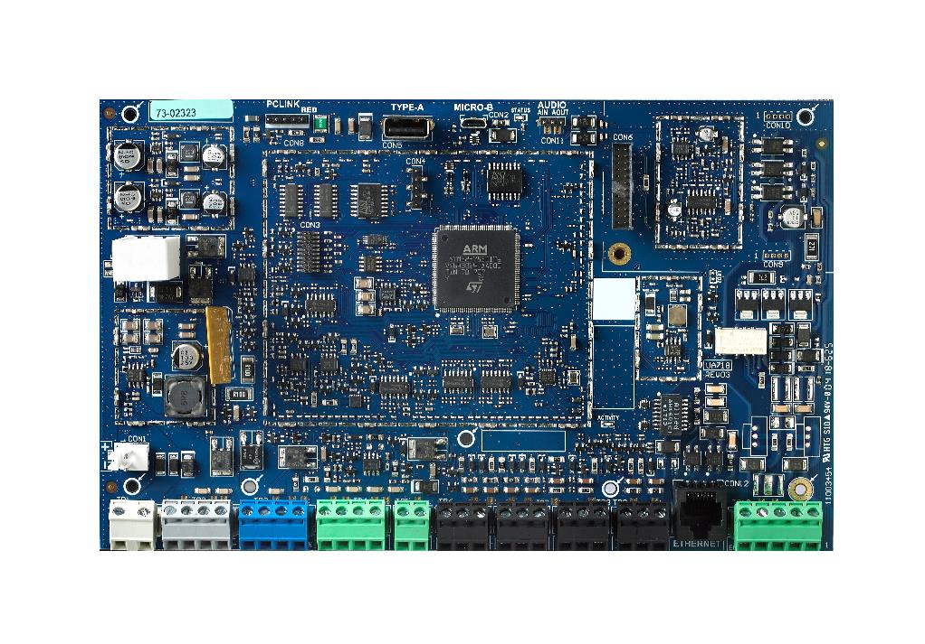
PowerSeries PRO …
LARGE SCALE INDUSTRIAL / SCALABLE COMMERCIAL HYBRID SOLUTION
    Certified Grade 3 according EN50131 normative
    Versions: 32 / 128 / 254 zones, wired or wireless
    32 partitions
    32 keypads
    1000 user codes
    1000 event buffer + 2000 priority event buffer + 100 arming event buffer
    4 on-board output “open collector” PGM
    Alarm protocols: Contact ID, SIA
    Encrypted Communications Bus, 128 Bit AES Encryption
    Motherboard integrated Ethernet communication module
    Visual alarm verification in day and night, in case of alarm from Motion Detector with Integrated Camera
32 to 128 zone control panel
(HS3032 / HS3128 / HS3248)

Slide 9
JCI Comprehensive Solutions …
 | DSC NEO | PM 30 | PM 360R |  | DSC PRO
 | HS 2016 | HS 2032 | HS 2064 | HS 2128 | HS 3032 | HS 3128 | HS 3248
EN50131 certificate | Grade 2 | Grade 2 | Grade 2 | Grade 2 | Grade 3 | Grade 3 | Grade 3
PCB wired zones | 6 | 8 | 8 | 8 | 8 | 8 | 8
Wireless zones | 16 | 32 | 64 | 128 | 32 | 128 | 128
Total zones | 16 | 32 | 64 | 128 | 32 | 128 | 248
PGM outputs on mainboard | PGM 1 = 50mA PGM 2 = 300mA | PGM 1 = 50mA PGM 2 = 300mA | PGM 1,3,4 = 50mA PGM 2 = 300mA | PGM 1,3,4 = 50mA PGM 2 = 300mA | PGM 1,4 = 100mA PGM 2,3 = 300mA | PGM 1,4 = 100mA PGM 2,3 = 300mA | PGM 1,4 = 100mA PGM 2,3 = 300mA
PGM total outputs | 16 x 50mA 4 x 500mA | 32 x 50mA 4 x 500mA | 64 x 50mA 12 x 500mA | 128 x 50mA 16 x 500mA | 32 x 50mA 4 x 500mA 4 x 2A relay | 128 x 50mA 16 x 500mA 23 x 2A relay | 128 x 50mA 16 x 500mA 32 x 2A relay
Partitions | 2 | 4 | 8 | 8 | 4 | 8 | 32
Event Buffer | 500 | 500 | 500 | 1000 | 500+2000+100+ 100 | 1000+2000+100+ 100 | 1000+2000+100+ 100
Keypads | 8 | 8 | 8 | 16 | 8 | 16 | 32
User Codes | 48 | 72 | 500 | 1000 | 72 | 1000 | 1000
Wireless sirens | 4 | 8 | 8 | 16 | 8 | 16 | 16
Wireless repeaters | 4 | 8 | 8 | 8 | 8 | 8 | 8
LTE Cellular & IP Ethernet | P | P | P | P | P | P | P
Wired Corbus length | 305 m | 305 m | 305 m | 305 m | 4200 m | 4200 m | 4200 m
PSTN communicator | P | P | P | P | P | P | P
Receivers | 4 | 4 | 4 | 4 | 4 | 4 | 4
Encrypted communications | P | P | P | P | P | P | P

Slide 10
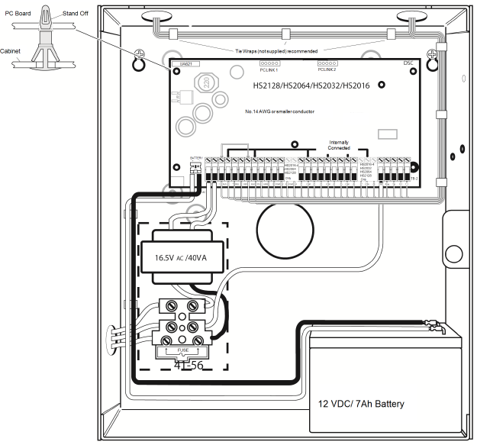


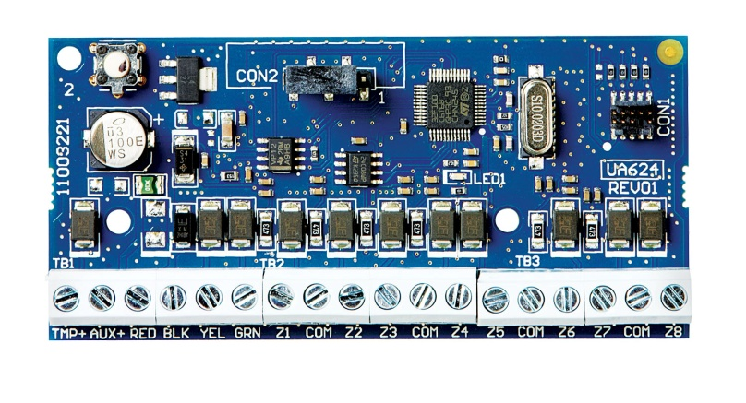
NEO / PRO wired detection structure
You can install a fully wired system !
NEO or PRO mainboard
keypad
wired zone module
CORBus

Slide 11
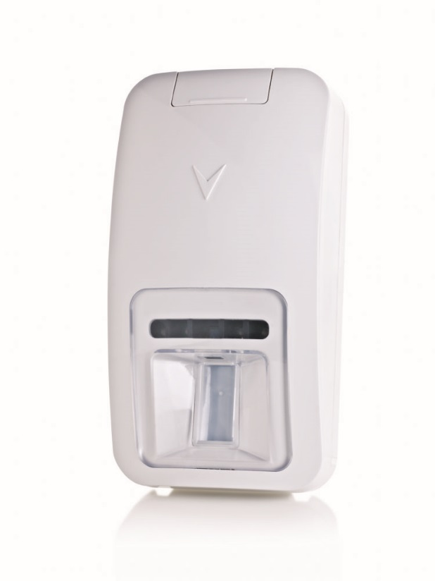
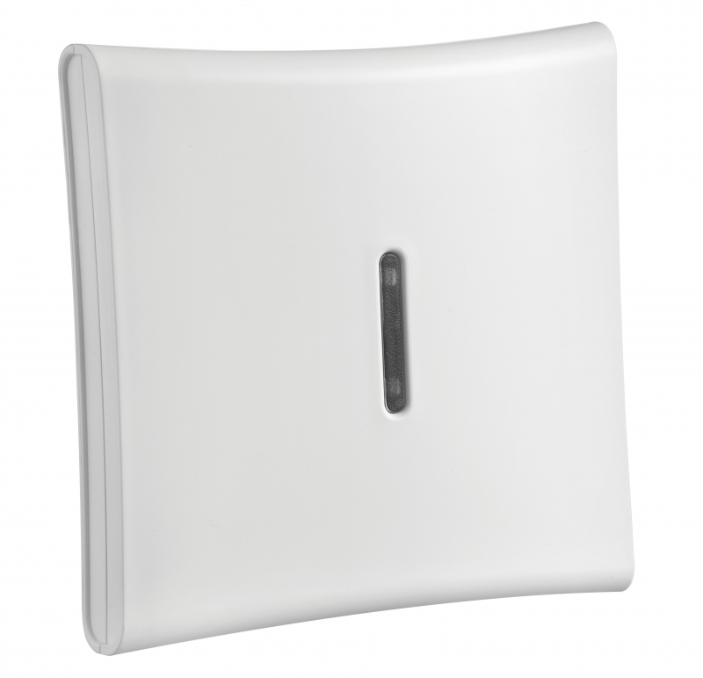

NEO / PRO wireless detection structure var.1
You can install a fully wireless system !
NEO or PRO mainboard
keypad
PowerG transceiver
CORBus

Slide 12
NEO / PRO wireless detection structure var.2
You can install a fully wireless system !
NEO or PRO mainboard
Keypad with PowerG transceiver
CORBus

Slide 13
NEO / PRO hybrid detection structure
You can install a hybrid system: any combination of wired and wireless !
NEO mainboard
Keypad with PowerG transceiver
wired zone module
CORBus

Slide 14
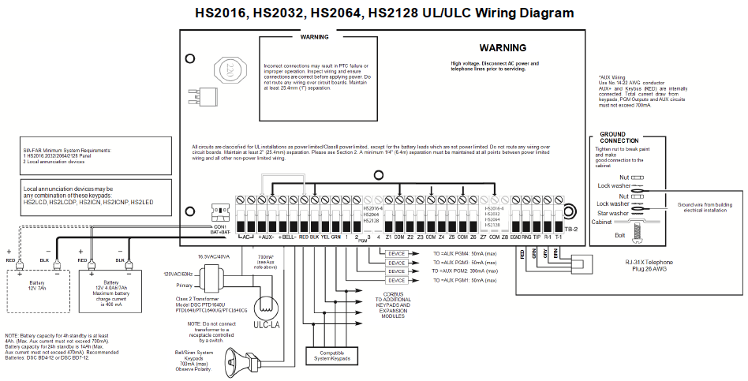
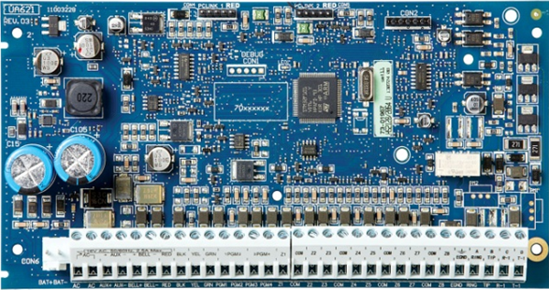
PowerSeries NEO mainboard – the same mainboard …

Slide 15
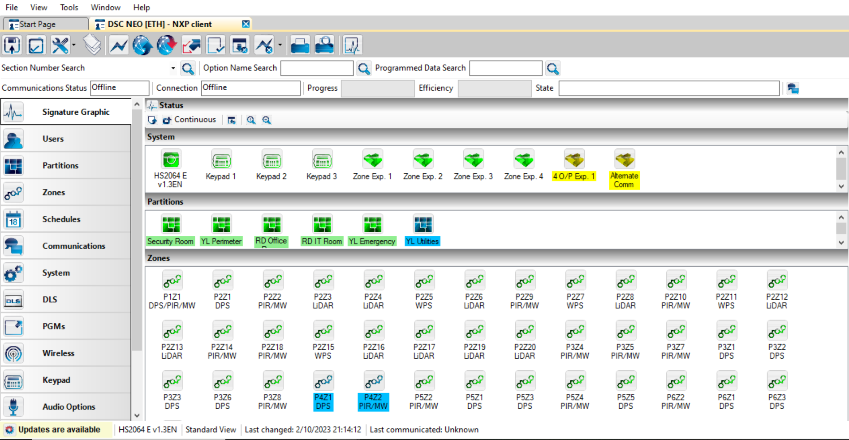
The same DLS5 pc-based programming software …

Slide 16

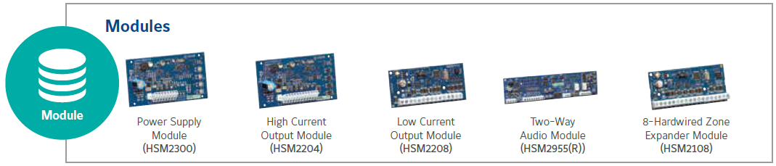
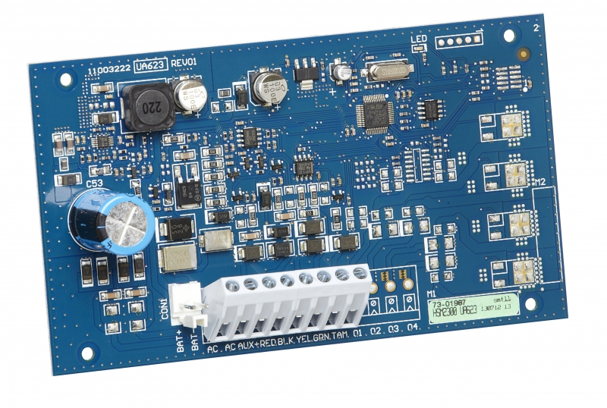
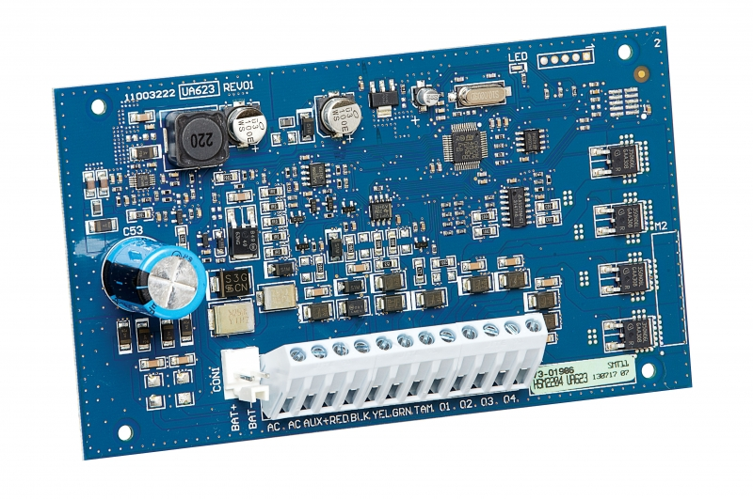
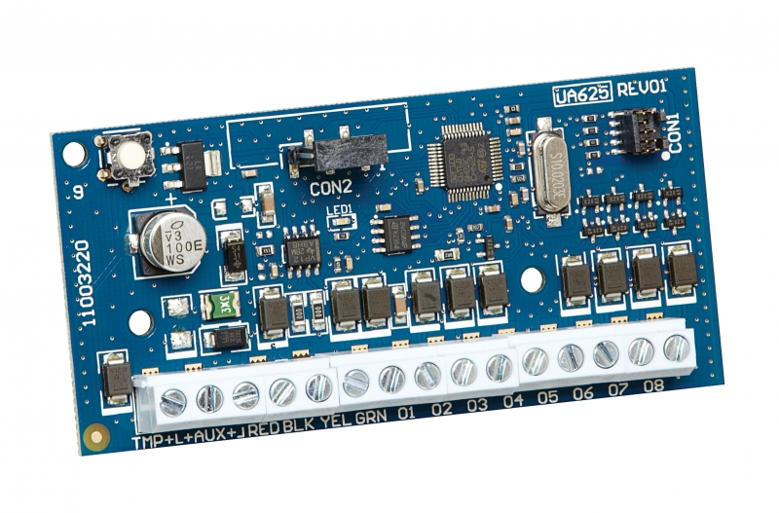

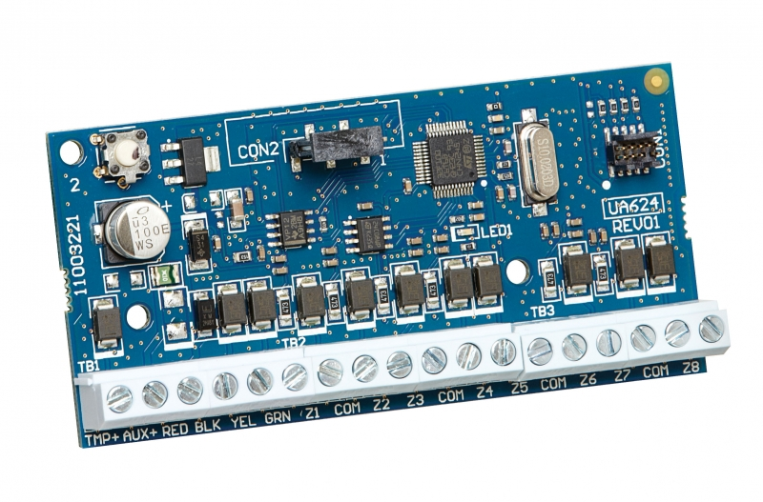
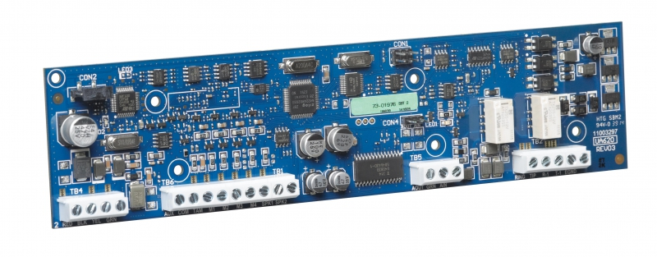
PowerSeries NEO bus expansion modules
HSM2300 - Provides up to 1 Amp @ 12 VDC, Fully supervised for AC failure, low battery and AUX failure
HSM2204 - 4 programmable high current voltage outputs: rated at 1 Amp @ 12 VDC
HSM2208 - Provides 8 low current (50 mA) programmable outputs
HSM2955 - 4 two-way audio stations, Supports both 2-way audio VOX and push-to-talk verification, Silent/Listen-in functionality on hold-up alarms (activates only when an alarm occurs), Two-way audio over PSTN or Cellular
HSM2108 - Adds 8 hardwired zones, AUX power up to 125 mA (PTC protected)

Slide 17

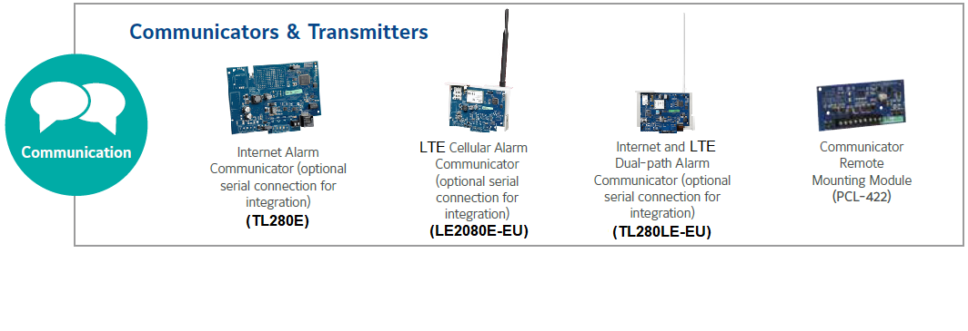
PowerSeries NEO alternative communicators
PowerManage cloud server

Slide 18
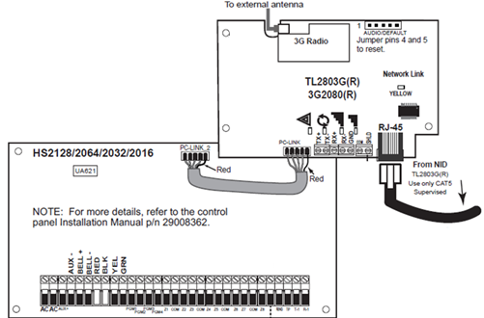
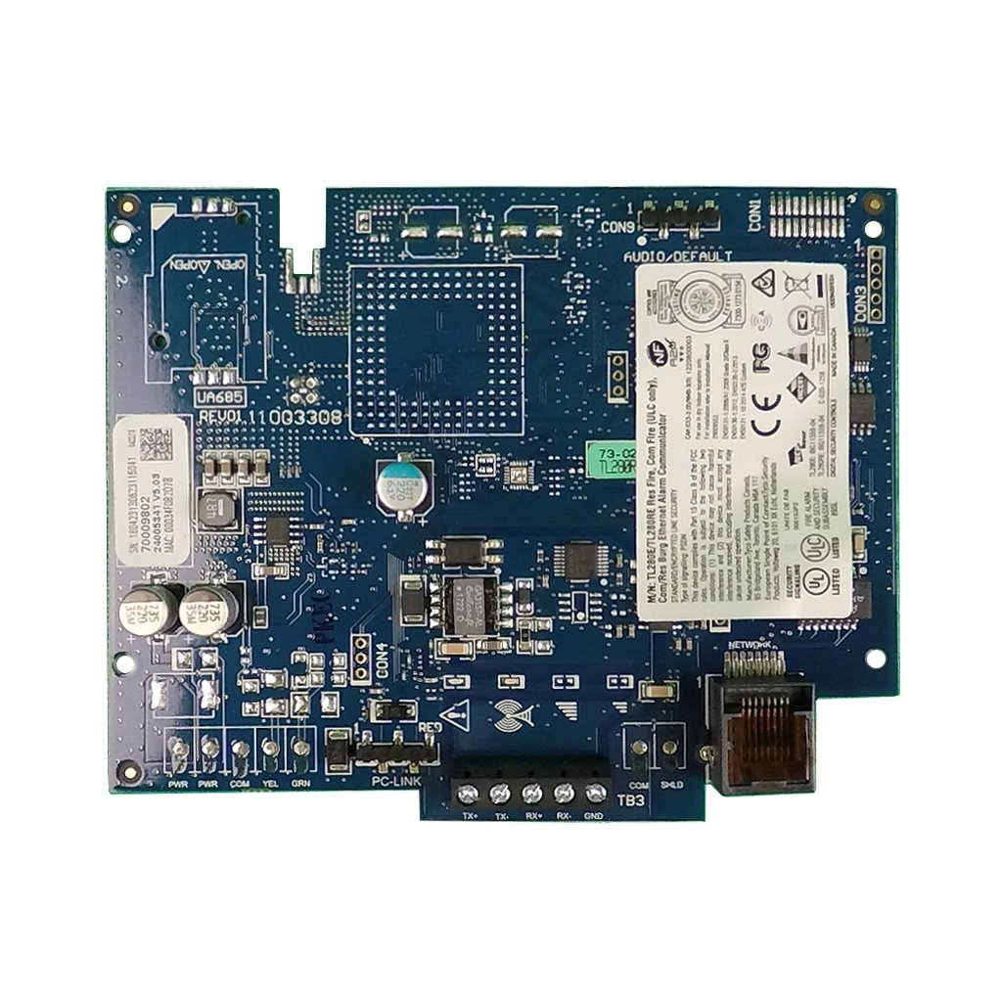

PowerSeries NEO Ethernet communicator TL280E
  TL280E – Ethernet communicator designed to offer possibility to use free-of-charge mobile applications for user and for installer
  Communicator will also send data to PowerManage or Surgard receiver stations, or to other protocol compatible security management software.
Communication Supervision and 128-bit AES encryption
Visual verification using PIRCam’s over Ethernet
Possible to report to 2 different Receivers with communications priority programming

Slide 19
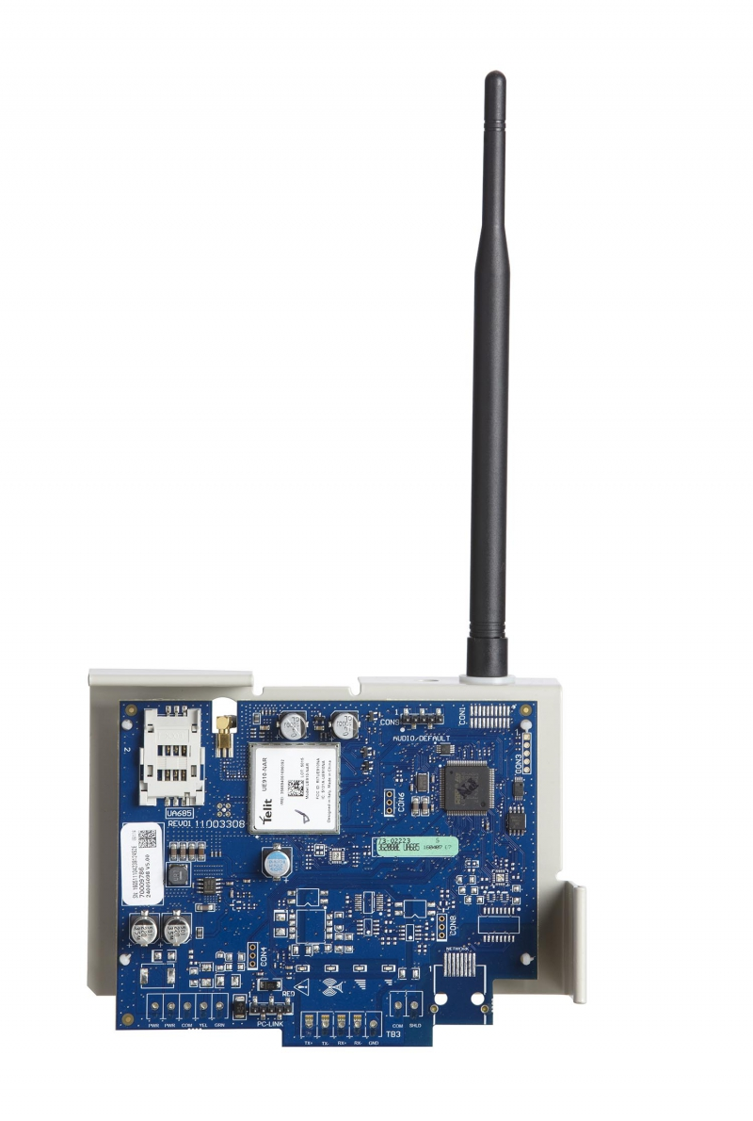
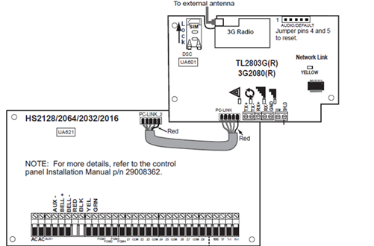
PowerSeries NEO Cellular communicator LE2080E-EU
  LE2080E-EU – Cellular LTE communicator designed to offer possibility to use free-of-charge mobile applications for user and for installer. If 4G/LTE network is not available, will switch to 3G or 2G.
  Communicator will also send data to PowerManage or Surgard receiver stations, or to other protocol compatible security management software.
Communication Supervision and 128-bit AES encryption
Visual verification using PIRCam’s over Cellular
Possible to report to 2 different Receivers with communications priority programming

Slide 20
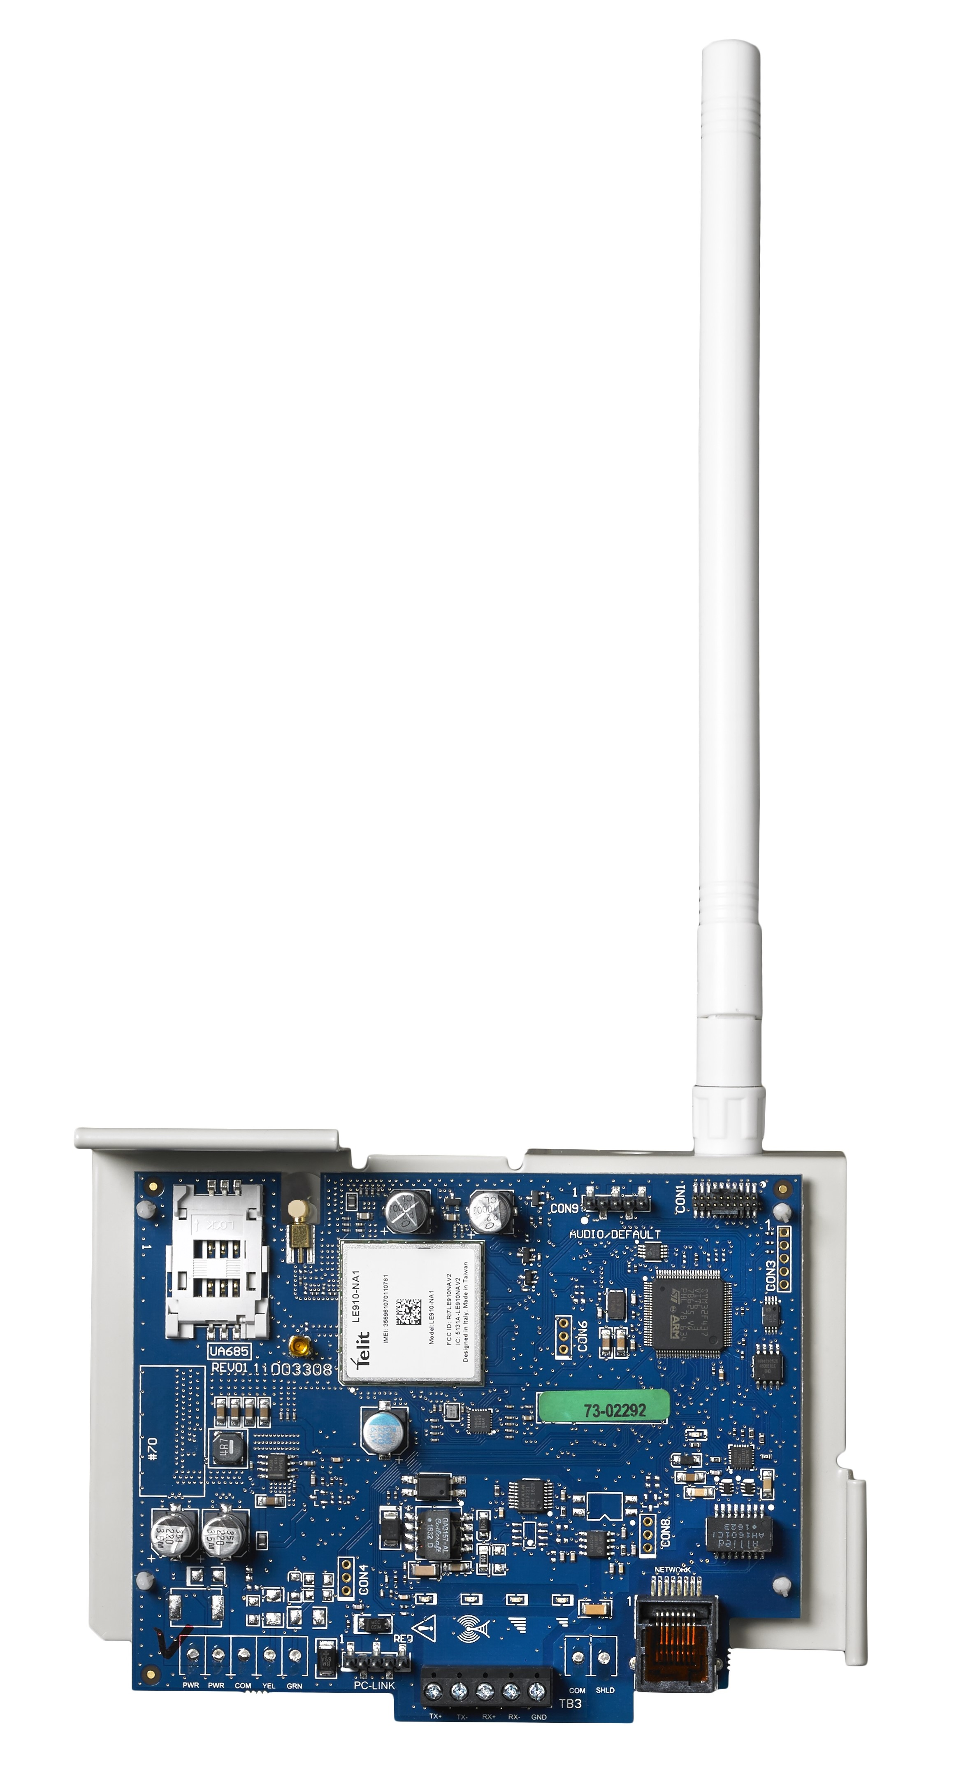
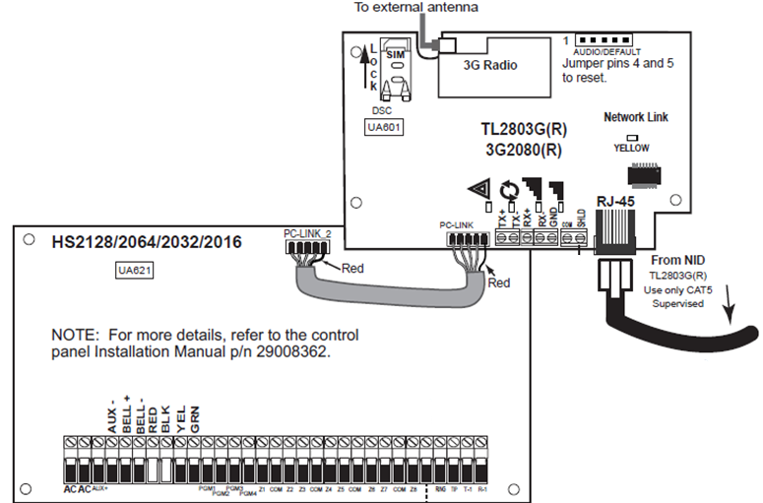
PowerSeries NEO Ethernet & Cellular communicator TL280LE-EU
  TL280LE-EU – Ethernet & Cellular LTE communicator designed to offer possibility to use free-of-charge mobile applications for user and for installer. If 4G/LTE network is not available, will switch to 3G or 2G.
  Communicator will also send data to PowerManage or Surgard receiver stations, or to other protocol compatible security management software.
Communication Supervision and 128-bit AES encryption
Visual verification using PIRCam’s over Ethernet & Cellular
Possible to report to 4 different Receivers with communications priority programming

Slide 21
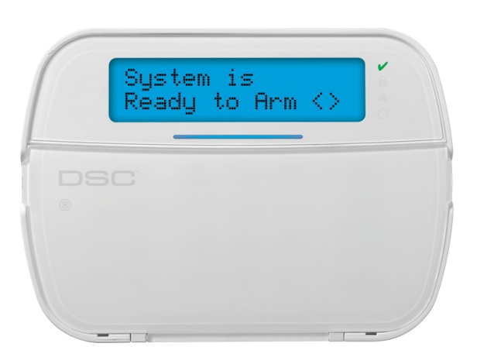
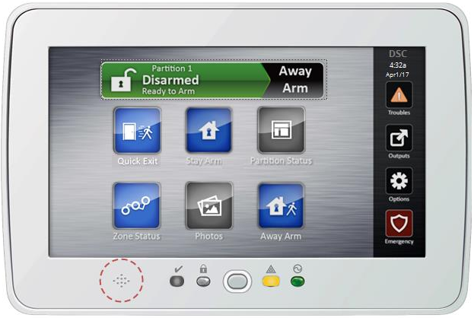
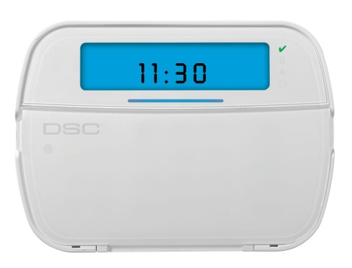
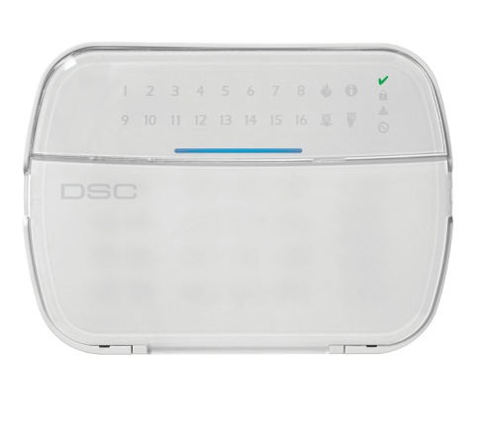
PowerSeries NEO keypad variants
HS2LCD(WF)(RF) – LCD Text keypad
HS2TCH – Touchscreen keypad
HS2ICN(RF) – LCD Icon keypad
HS2LED – 16 Zone LED keypad

Slide 22

PowerSeries NEO keypad variants
Several variants who offer a combination of the following functions:
  PROX receiver (P)
  Wireless communication (WF)
  Vocal module (V – possible only for one wireless variant)
  PowerG transceiver for wireless devices communication (RF)
  Touchscreen (TCH)
The code number inside means the communication frequency (8 = 868MHz)
** those variants are highly recommended to be used for the system programming
Model # | Description
HS2LCD ** | LCD text keypad
HS2LCDP ** | LCD text keypad + Prox receiver
HS2ICN | ICON keypad
HS2ICNP | ICON keypad + Prox receiver
HS2LED | LED keypad
HS2LCDRF8 ** | LCD keypad with RF 868MHz module
HS2LCDRFP8 ** | LCD keypad + Prox receiver with RF 868MHz module
HS2ICNRF8 | ICON keypad with RF 868MHz module
HS2ICNRFP8 | ICON keypad + Prox receiver with RF 868MHz module
HS2LCDWF8 | LCD wireless keypad 868MHz
HS2LCDWFP8 | LCD wireless keypad 868MHz + Prox receiver
HS2LCDWFPV8 | LCD wireless keypad 868MHz + Prox receiver + voice module
HS2TCHP ** | Touchscreen keypad + Prox receiver

Slide 23
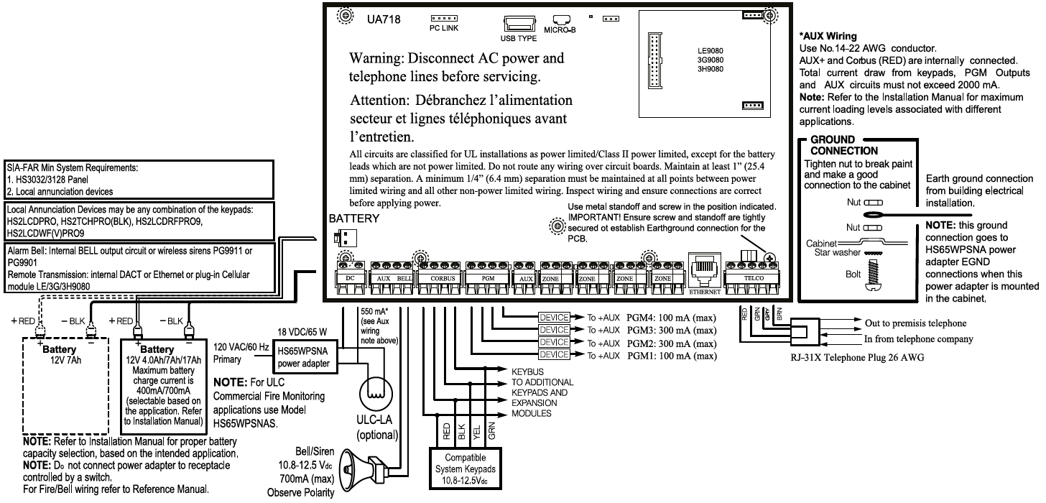
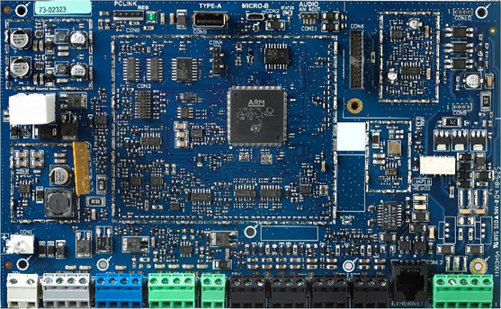
PowerSeries PRO mainboard – slightly improved mainboard …

Slide 24

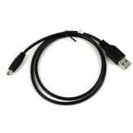

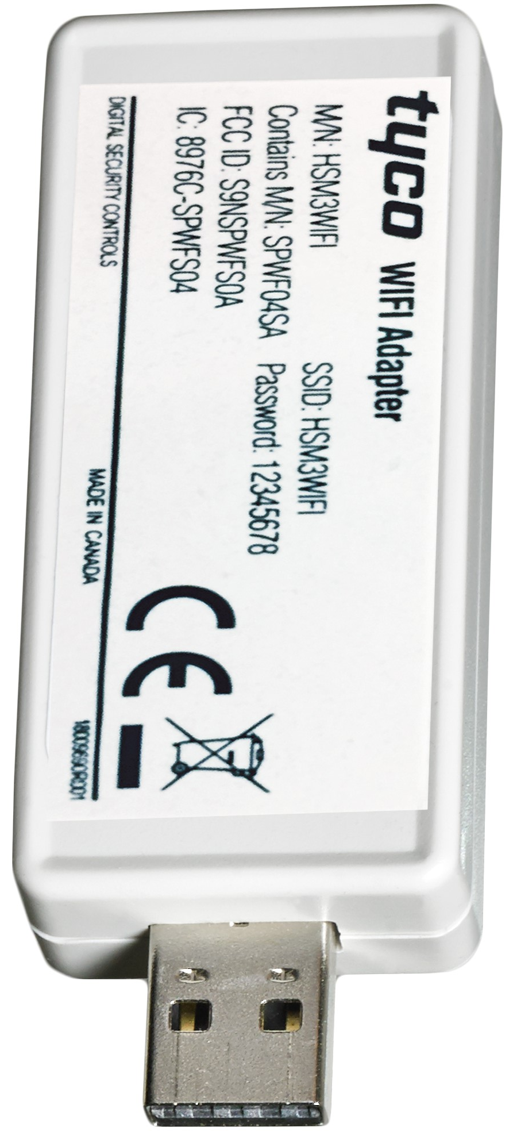

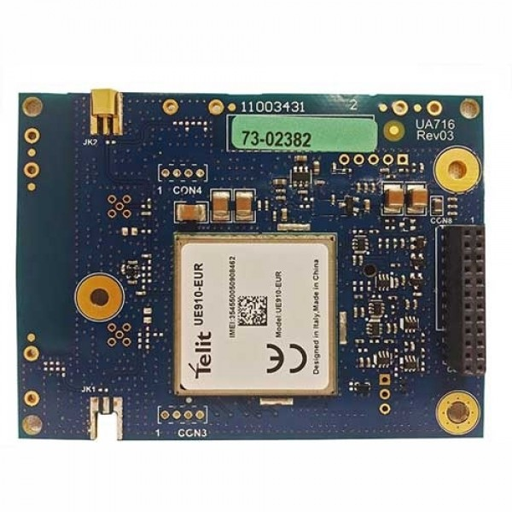
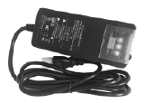
PowerSeries PRO mainboard – slightly improved mainboard …
Note: Power supply may be mounted outside the
cabinet. Use the following guide to determine maximum distance for the selected wire gauge:
DISTANCE DIAMETER
2 meters 0.64 mm
3 meters 0.81 mm
4 meters 1 mm
USB Interfaces
Type A & Micro
Modular Cellular Communicator
DC Power Supply
Level 6 Efficiency Approved
On board Ethernet
Removable Terminal Blocks

Slide 25
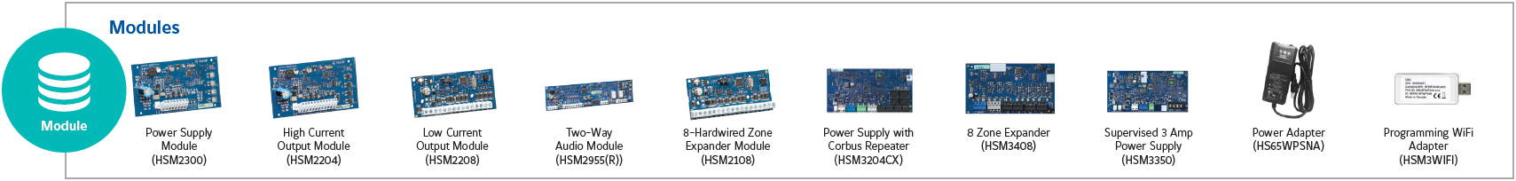
PowerSeries PRO bus expansion modules
HSM3204CX - Provides 2A @ 12 VDC with Bus Repeater, low battery and AUX failure
HSM3408 - Adds 8 hardwired zones, AUX power up to 500 mA (PTC protected)
HSM3350 - Provides up to 3A @ 12 VDC, fully supervised for AC failure, low battery and AUX failure
HS65WPS - is the Power Adapter used for the PS-PRO main panel and its power supply modules
HSM3WIFI - Provides Wi-Fi Interface for Local Programming
HSM2300 - Provides up to 1A @ 12 VDC, fully supervised for AC failure, low battery and AUX failure
HSM2204 - 4 programmable high current voltage outputs: rated at 1 Amp @ 12 VDC
HSM2208 - Provides 8 low current (50 mA) programmable outputs
HSM2955 - 4 two-way audio stations, Supports both 2-way audio VOX and push-to-talk verification, Silent/Listen-in functionality on hold-up alarms (activates only when an alarm occurs), Two-way audio over PSTN or Cellular
HSM2108 - Adds 8 hardwired zones, AUX power up to 125 mA (PTC protected)

Slide 26
PowerSeries PRO communicators
Ethernet communication module included in the PRO motherboard
Cellular communication module can be added by request
If it’s necessary, there are available external antenna kits:
  ANTLTE-02 – 2 m antena wire – For Indoor only
  ANTLTE-10 – 10 m antena wire - For Indoor or Outdoor
PowerManage cloud server
Modular Cellular Communicator
On-board Ethernet

Slide 27
PowerSeries PRO keypad variants
HS2LCD(WF)(RF) – LCD Text keypad
HS2TCH – Touchscreen keypad
HS2ICN(RF) – LCD Icon keypad
HS2LED – 16 Zone LED keypad

Slide 28
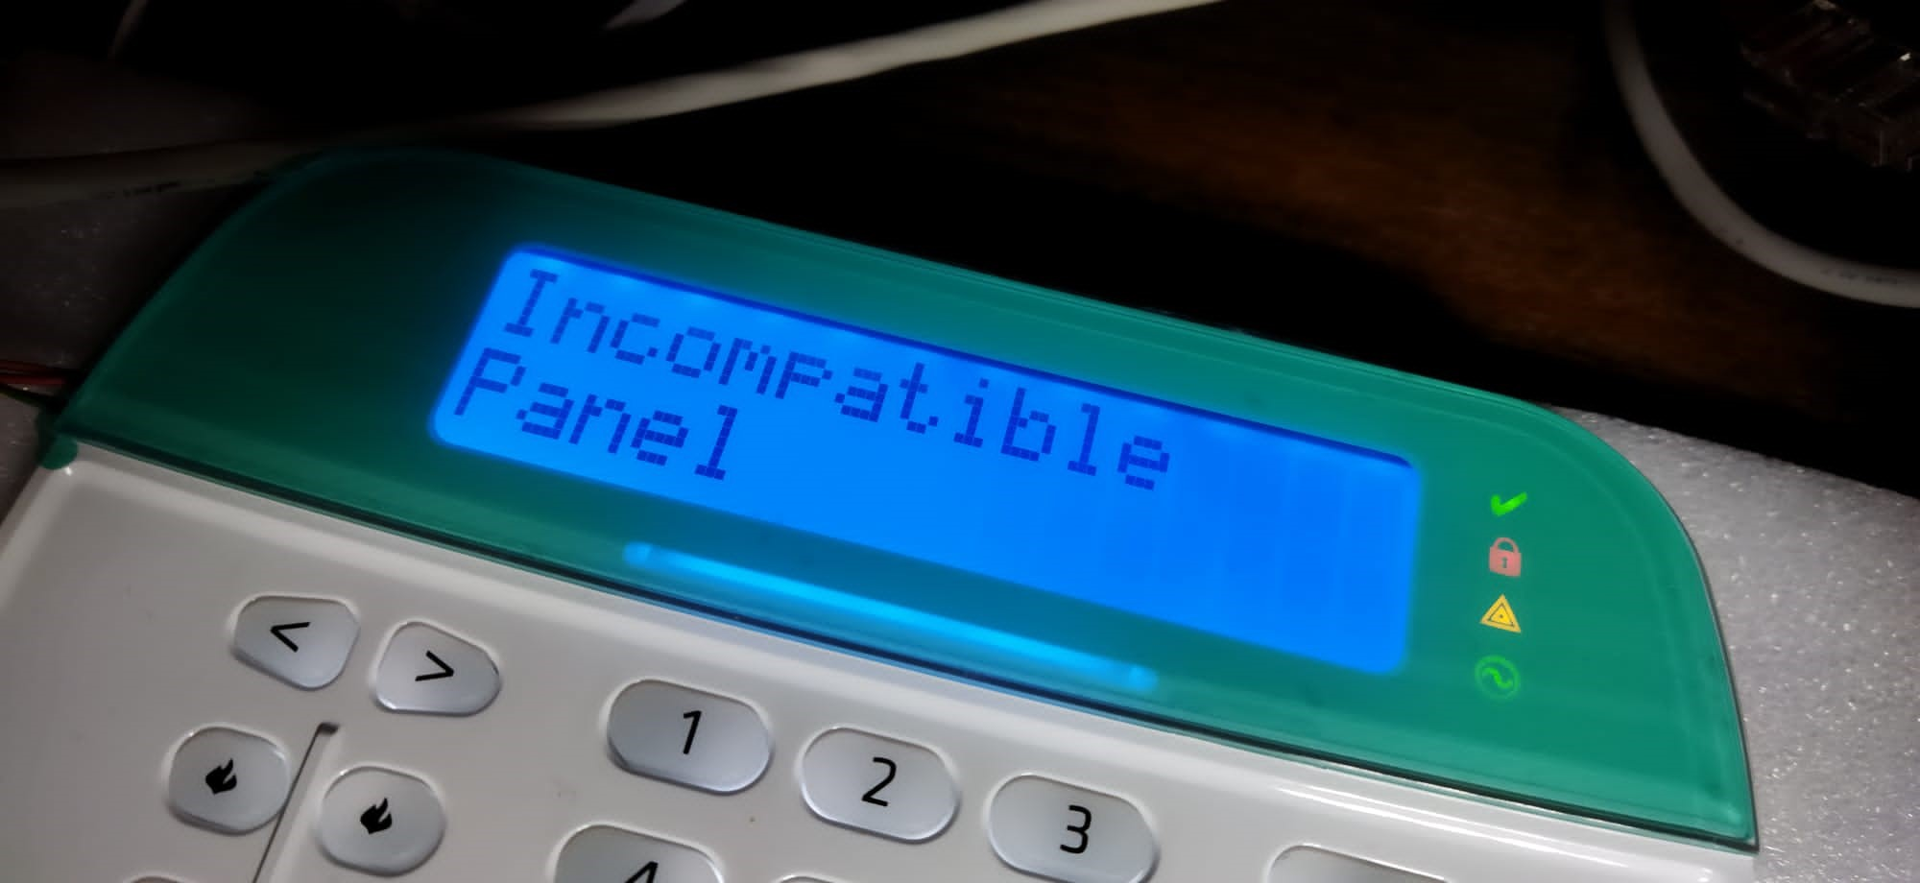
JCI Comprehensive Solutions …
NOTE: NEO keyboards and PRO panels are not compatible one to each other …

Slide 29
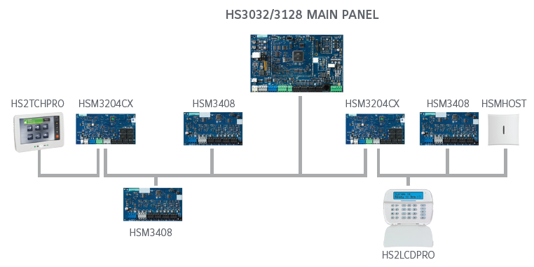
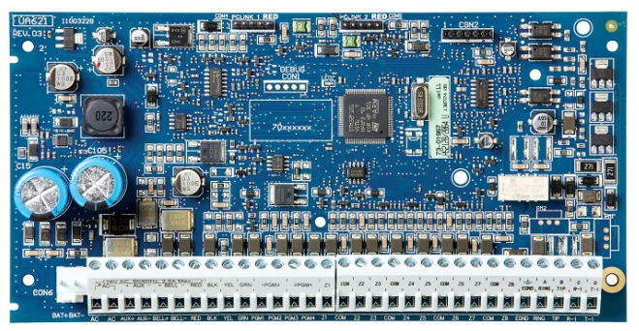
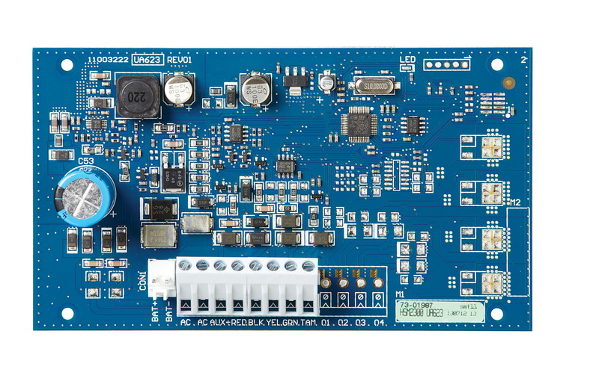
Ansamblu centrala NEO – bus max. 300m
HS2016/2032/2064/2128 MAIN PANEL
HS2TCH HSM2300 HSM2108
HSM2300 HSM2108
300 m !
HSM2108
HS2LCD

Slide 30

Ansamblu centrala PRO – bus max. 4200m
4.2 km !

Slide 31
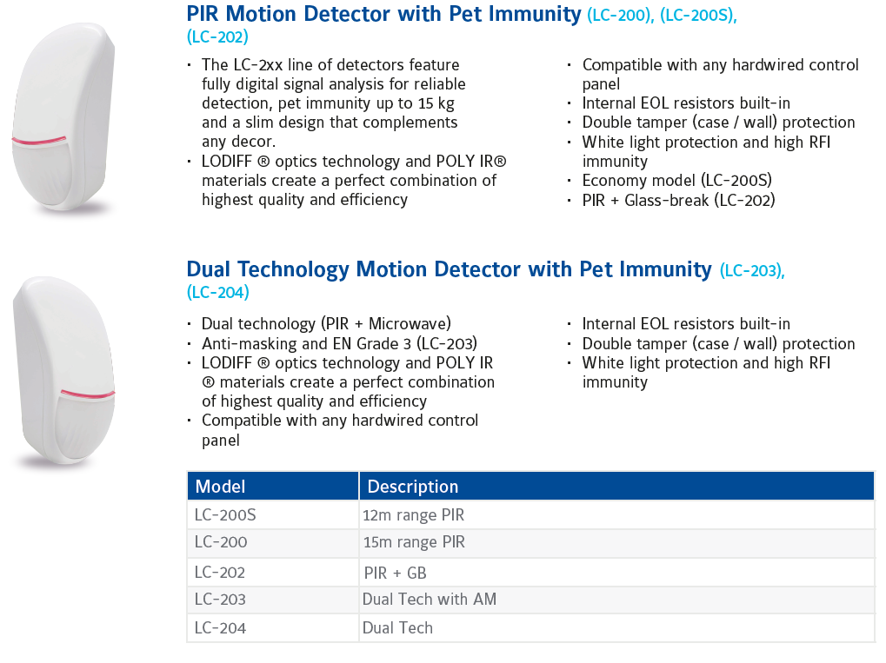
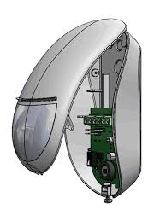
Newer JCI wired conventionally PIR detectors …

Slide 32


The Power of PowerG …
Frequency Hopping Spread Spectrum – FHSS
Time Division Synchronized System – TDSS
Full Two-Way Communication – FTWC
128-bit AES Encryption
Adaptive Power & Path – for PowerG wireless environment
Long Line of Sight – max. 2 km
Jamming Detection – according EN, UL or BS standards

Slide 33


PowerG – wireless Magnetic Contacts

Slide 34

PowerG – wireless PIR detectors

Slide 35
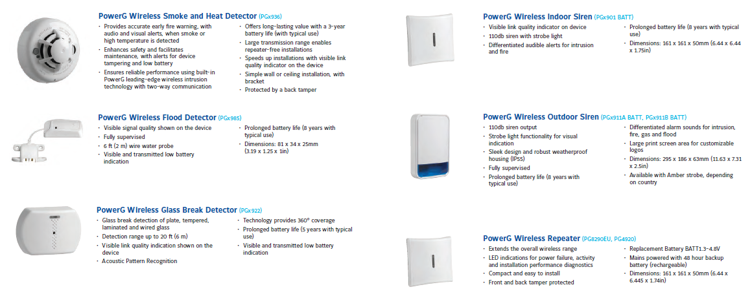
PowerG – wireless Safety detectors, Sirens, etc.

Slide 36
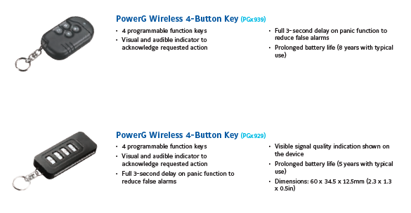

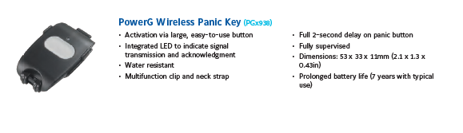
PowerG – wireless Keyfobs and Panic Buttons

Slide 37




JCI Interactive mobile apps …
Interactive app (iOS and Android) for end-users, based on public or private PowerManage servers
Enable end user to control alarm system (arm, disarm, status, video)
Great tool for monitoring companies to increase their offering
Can be used by distributors with minimum maintenance needed
Push notifications support
  User Installer
  PRO direct programming

Slide 38

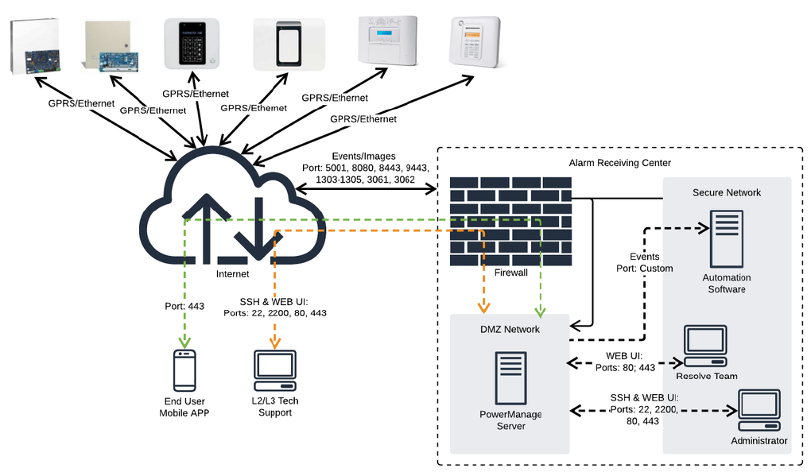
PowerManage server connectivity

Slide 39
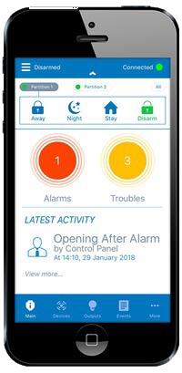
JCI ConnectAlarm – client dedicated app
  ConnectAlarm is a cloud-based mobile app that provides home and business owners with real-time control over their security system, from anywhere, at any time
  Supports iOS 8.0 and Android 4.4 & up
  Works now with DSC and Visonic panels
  Suitable for monitored and self-monitored systems
  Allow Push Notifications and multiple users, defined by Master User
  Allow installer remote connection for service purposes, after Master User approval
  Here https://youtu.be/IUEScQ-EGe0 is an explanatory video regarding ConnectAlarm

Slide 40
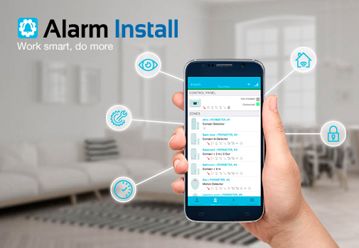
JCI AlarmInstall – installer dedicated app
The Alarm Install App provides the convenience of configuring an alarm security system from your mobile device or tablet
To allow the installer access to an alarm panel, the user must approve access from the Panel Settings menu of the User App. This permission is required only if Allow user to approve installer login option is selected in the PowerManage MMI console

Slide 41

JCI Video integrations …

Slide 42

JCI Comprehensive Solutions …

Slide 43
Contact
THANK YOU !
Narcis Pica
Technical Sales Manager, Security Products
Building Technologies & Solutions
Johnson Controls
narcis.pica@jci.com

